Slide 1
Porting 8.1 Apps to Windows 10 Developer's Guide to Windows 10

Slide 2
Agenda
Migration Paths to Windows 10 UWP
Windows 8.0/8.1 Store Apps
Windows Phone 8.1 Store Apps (WinRT)
Windows 8.1 Universal Apps
Windows Phone Silverlight Apps
Migrating a Windows 8.1/Windows Phone 8.1 Project
Upgrade Utility
Additional Migration Steps
Migrating 8.1 Universal Apps
Migrating Universal Apps
Handling the Shared Project

Slide 3
Extend your app to multiple device families and use new capabilities by targeting the UWP

Slide 4
Migration Paths to Windows 10

Slide 5
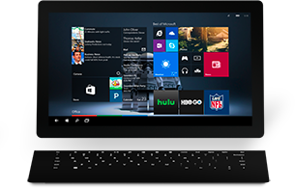
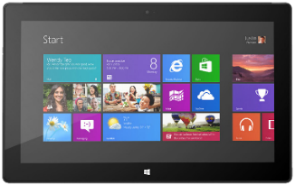

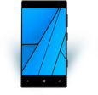
Windows 8.0/8.1 Store Apps
Minimal code update required
Responsive UX Design/Implementation
Windows 8.0
Windows 10

Slide 6

Windows Phone 8.1 Store Apps (WinRT)
Windows Phone 8.1
Windows 10
Minor code updates for UWP APIs
Design UX for multiple form factors

Slide 7
Windows 8.1 Universal Apps
Merge UX
Refactor to single code-base & to target UAP APIs
Windows 8.1
Windows 10
Windows Phone 8.1

Slide 8
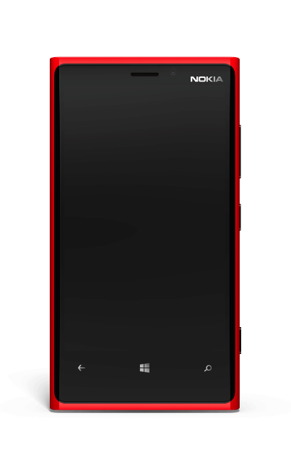

Windows Phone Silverlight Apps
Port the UI Silverlight -> Windows XAML
Rewrite code to target UWP APIs*
Design UX for multiple form factors
Windows Phone 7.5/7.8
Windows 10
Windows Phone 8.0
Windows Phone 8.1*
*Silverlight on Windows Phone 8.1 can be a mix of Silverlight and WinRT APIs

Slide 9
Porting – What You Can Expect
8.1 WinRT app code needs few changes
App lifecycle, background execution, Tiles and toasts – all the same
UWP APIs are a superset of the Windows 8.1 WinRT APIs
Review/change logic that relied on compiler conditionals (#if…) to handle platform differences
A few APIs are deprecated (example, Phone 8.1 …AndContinue APIs)
Charms bar gone, so app must now incorporate UI to launch Settings, Share or Search
8.1 WinRT XAML UI ports across fairly easily
Though you have work to do if you want to build adaptive UI working across multiple device families
Care needed with deprecated and altered styles and with font size changes
Silverlight 7.x/8.x apps need reimplementation
Though these apps still run on Windows 10 Mobile devices!
Porting Tooling is coming! – More details announced soon

Slide 10
Porting a Windows 8.1 or Windows Phone 8.1 Project

Slide 11
Porting an 8.1 WinRT Project
Project file and package.appxmanifest need modifications
NuGet V2 -> NuGet V3
No upgrade wizard in the tools
…but I’ve written a PowerShell script to do most of the work ☺
Get it at https://github.com/Win10DevGuideMVA/ProjectUpgradeUtility/
Contribute!

Slide 12
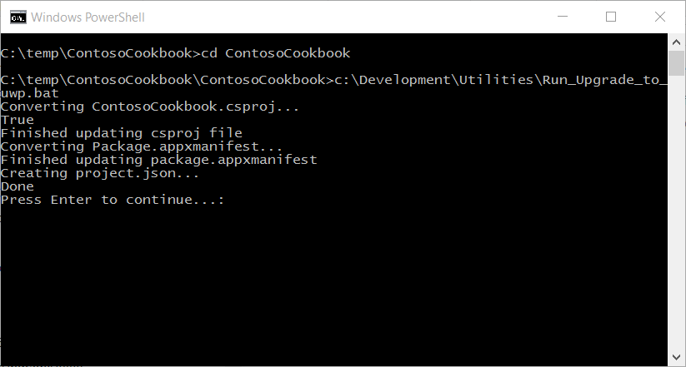
Upgrade_to_uwp PowerShell script
Automates most of the upgrade steps – doesn’t do everything!
Converts .csproj to UWP, updates package.appxmanifest
Run directly in Powershell (needs script execute allowed), or execute Run_Upgrade_to_UWP.bat at cmd prompt

Slide 13
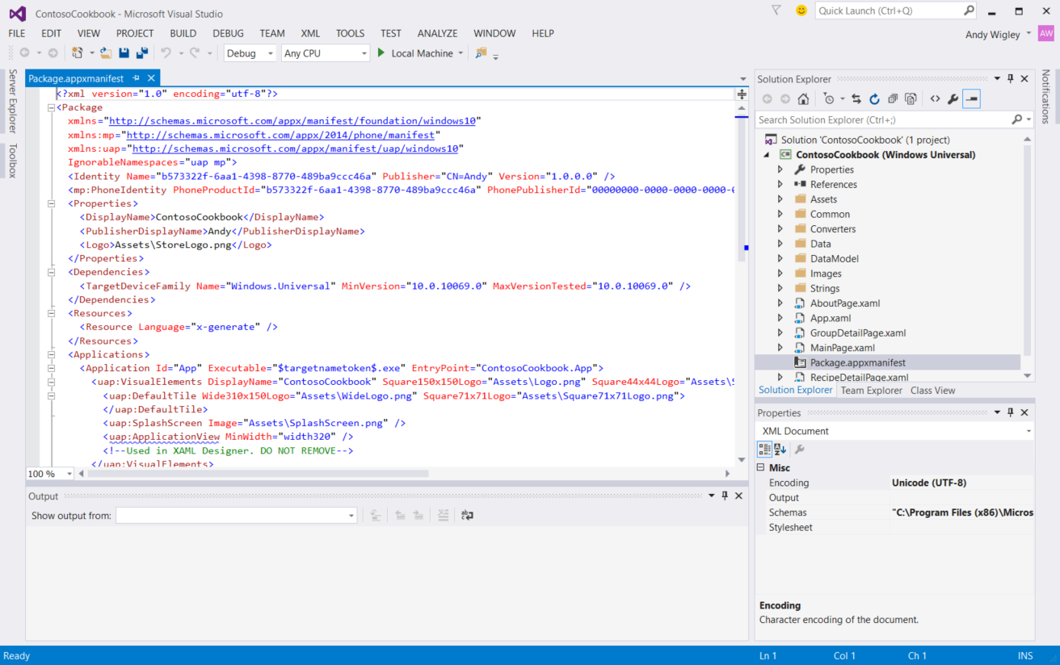
Updated Project

Slide 14
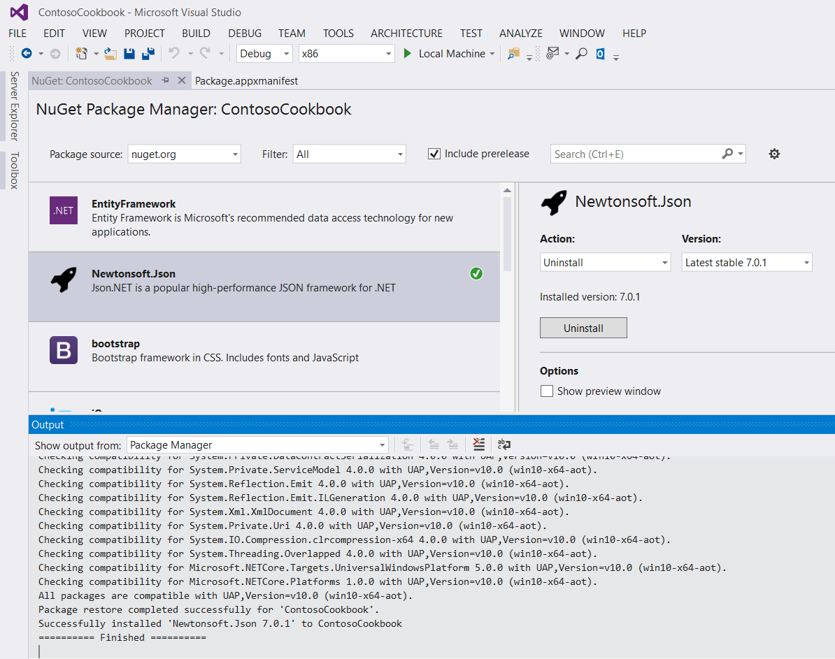
Add NuGet Packages
UWP apps uses NuGet V3
Packages no longer saved per solution in solution root directory
Packages.config file replaced by project.json configuration file
Package references resolved at Build time
Packages cached once per user in your C:\Users\username\.nuget

Slide 15
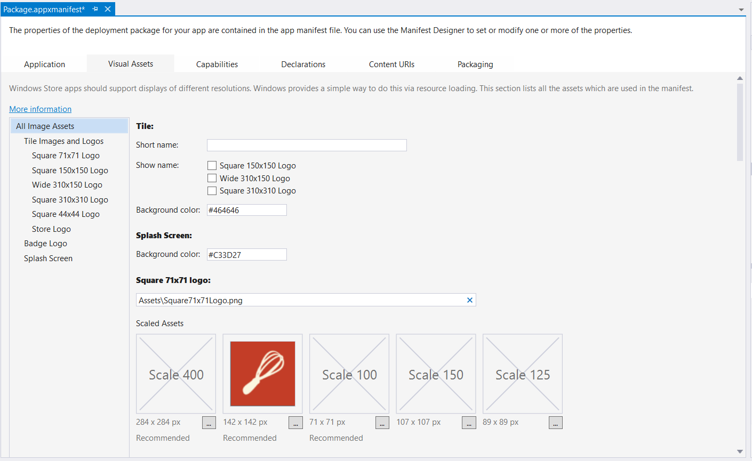
Update your Artwork
May need to change tile sizes and scaling:
Supported Scale factors now: 100 – 125 – 150 – 200 – 400
Standardised across all device families

Slide 16
New scale factors
Scale Factors | 100 | 125 | 150 | 200 | 250 | 300 | 400
Single scale factor system for all apps
Great alignment with other app platforms
Guarantees consistent visual size of text and graphics (abstracts panel density and viewing distance for you)
100%, 200% and 400% are the most important sizes to support in assets
Scale factors work well with 4-px grid

Slide 17
Window Sizes (launch and min size)
Minimum allowed Window width no longer set in manifest
Now: set in code using the ApplicationView class
PreferredLaunchViewSize
Size the app launches with if no size remembered by Windows – only takes effect on Desktop device that is not in Tablet mode
SetPreferredMinSize
Largest min size: 500x500px, Smallest min size: 192x48p
Call this on your view before call to Window.Activate
Example
ApplicationView.GetForCurrentView().SetPreferredMinSize(new Size(320, 320));

Slide 18
See MSDN documentation for guidance on how to Move from Windows Runtime 8 to UWP: http://aka.ms/movefrom8touwp

Slide 19
Demo: Porting an 8.1 XAML app

Slide 20
Additional Conversion Steps
Review conditional code (#if…) and convert to adaptive code where appropriate
Add Reference to Platform Extension SDKs, if needed
Replace calls to deprecated APIs, if any
Replace undefined and review retained styles in XAML
Update code that integrates with Charms bar
Extend your UI to create a great, adaptive UI that works across multiple device families!

Slide 21
1. Review #if conditional compilation
Compiler conditionals may be used in shared code:
this.Page.Loaded += (sender, e) =>
{
#if WINDOWS_PHONE_APP
Windows.Phone.UI.Input.HardwareButtons.BackPressed += HardwareButtons_BackPressed;
#else
// Keyboard and mouse navigation only apply when occupying the entire window
if (this.Page.ActualHeight == Window.Current.Bounds.Height &&
this.Page.ActualWidth == Window.Current.Bounds.Width)
{
// Listen to the window directly so focus isn't required
Window.Current.CoreWindow.Dispatcher.AcceleratorKeyActivated +=
CoreDispatcher_AcceleratorKeyActivated;
Window.Current.CoreWindow.PointerPressed +=
this.CoreWindow_PointerPressed;
}
#endif
};

Slide 22
Handling Back Button
Desktop: Enable Chrome back button
Single converged back button API
Example:
protected override void OnNavigatedTo(NavigationEventArgs e)
{
var frame = Window.Current.Content as Frame;
if (frame.CanGoBack)
{
SystemNavigationManager.GetForCurrentView().AppViewBackButtonVisibility = AppViewBackButtonVisibility.Visible;
}
else
{
SystemNavigationManager.GetForCurrentView().AppViewBackButtonVisibility = AppViewBackButtonVisibility.Collapsed;
}
SystemNavigationManager.GetForCurrentView().BackRequested += Page_BackRequested;
}

Slide 23
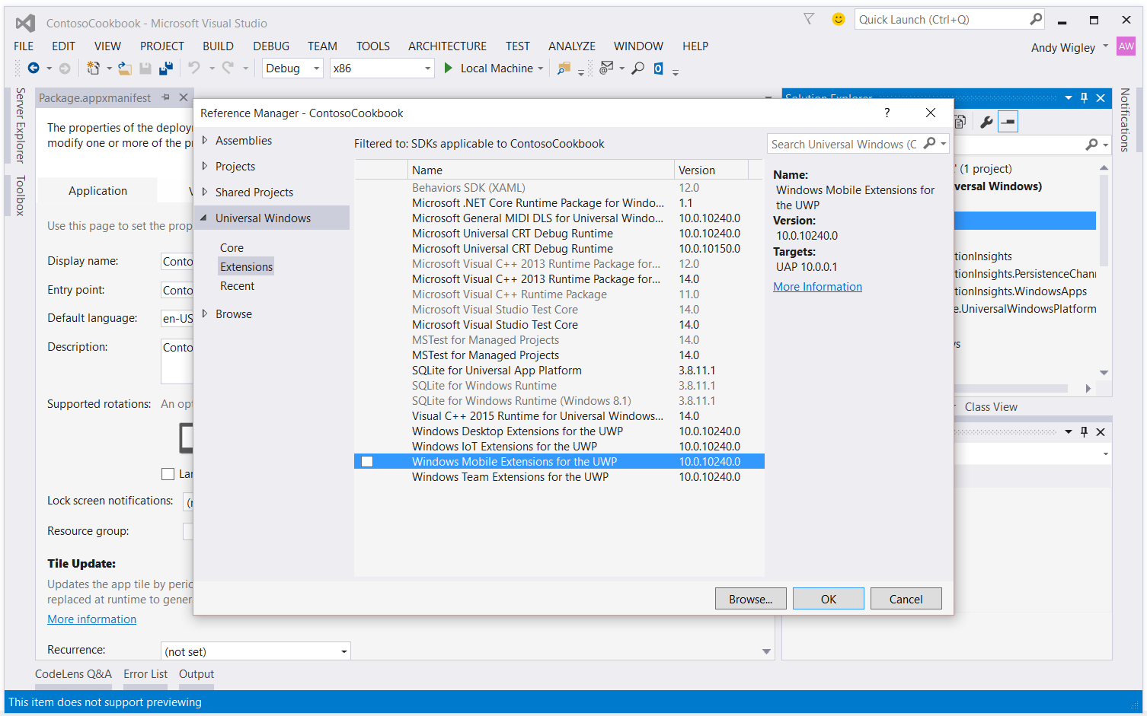
2. Add Ref for Platform extensions

Slide 24
Adaptive code
var api = "Windows.Phone.UI.Input.HardwareButtons";
if (Windows.Foundation.Metadata.ApiInformation.IsTypePresent(api))
{
Windows.Phone.UI.Input.HardwareButtons.CameraPressed += CameraButtonPressed;
}

Slide 25
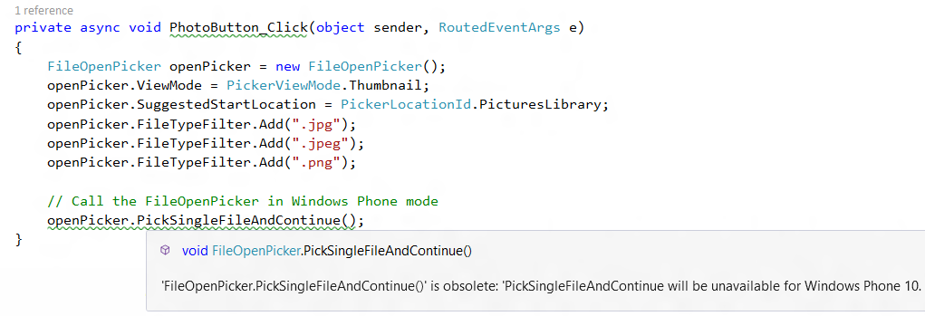
3. Replace Deprecated APIs

Slide 26
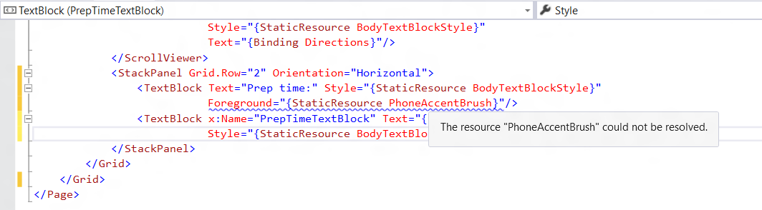
4. Review all use of Styles and Sizes
Replace undefined Styles in XAML with alternatives:

Slide 27
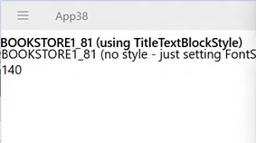
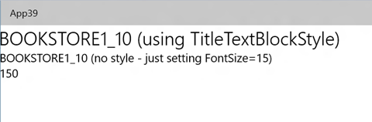
Scaling gotcha’s
Old scale factors may be larger now
140% -> 150% , 180% - > 200%?
Visual refresh has changed font sizes
Ex: TitleTextBlockStyle
(8.1) FontSize=14.667 (10.0) FontSize=24
Example (left 8.1 App, Right 10.0)

Slide 28
5. Update Charms Bar Integration Code
Charms bar not on Windows 10 devices
Replace with in-app UI for
Search
App Settings
Sharing
Underlying code does not change, just the users’ way of accessing them

Slide 29
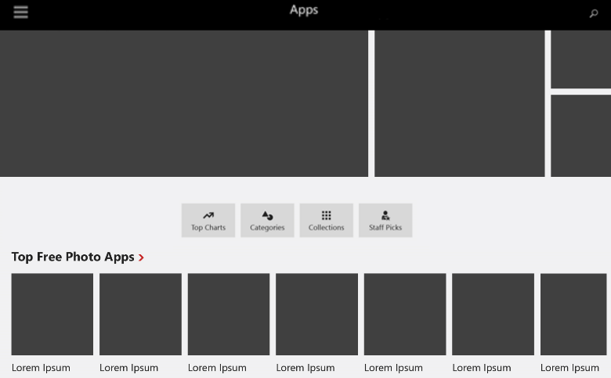
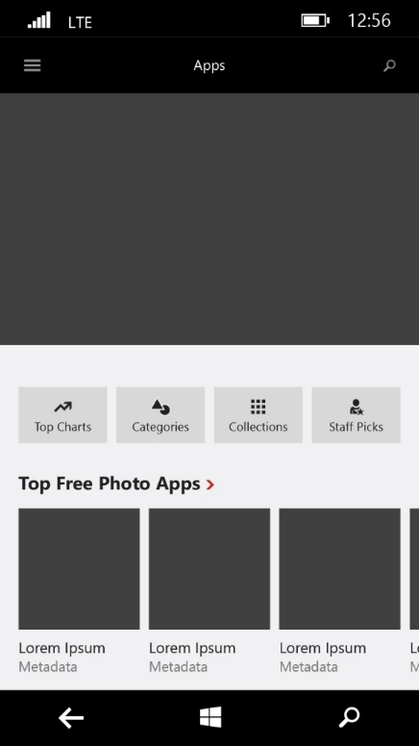
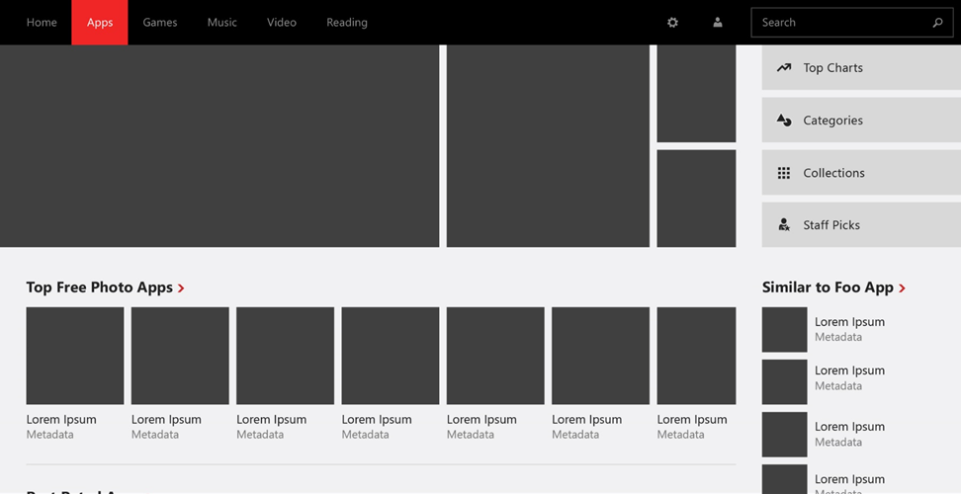
6. Create an awesome adaptive UI!
small landscape view
Phone/narrow view
large landscape view

Slide 30
Migrating 8.1 universal apps

Slide 31
What about 8.1 Universal apps?
Choose one head to port Phone or PC/Tablet
Merge UI from other head into adaptive UI Phone and PC/Tablet UI combined in the UAP project
Choose what to do with Shared Shared or merged

Slide 32
What to do with your Shared project?
You can keep your Shared project
WINDOWS_APP
WINDOWS_PHONE_APP
WINDOWS_UWP (new)
You may still need to include Windows.Foundation.Metadata.ApiInformation adaptive code checks for any APIs you use in Extension SDKs

Slide 33
Review
Migration Paths to Windows 10
Windows 8.0/8.1 Store Apps
Windows Phone 8.1 Store Apps (WinRT)
Windows 8.1 Universal Apps
Windows Phone Silverlight Apps
Migrating a Windows 8.1/Windows Phone 8.1 Project
Upgrade Utility
Additional Migration Steps
Migrating 8.1 Universal Apps
Migrating Universal Apps
Handling the Shared Project

